Slide 1
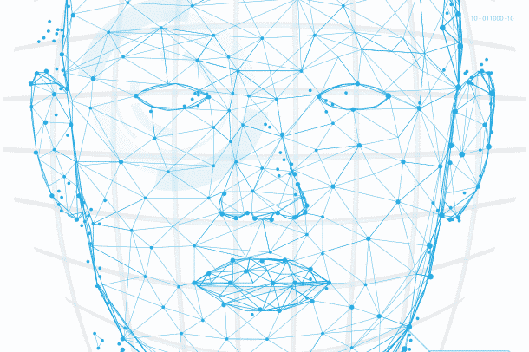
Face Recognition using CRI AI Thermal Camera
Final Presentation

Slide 2
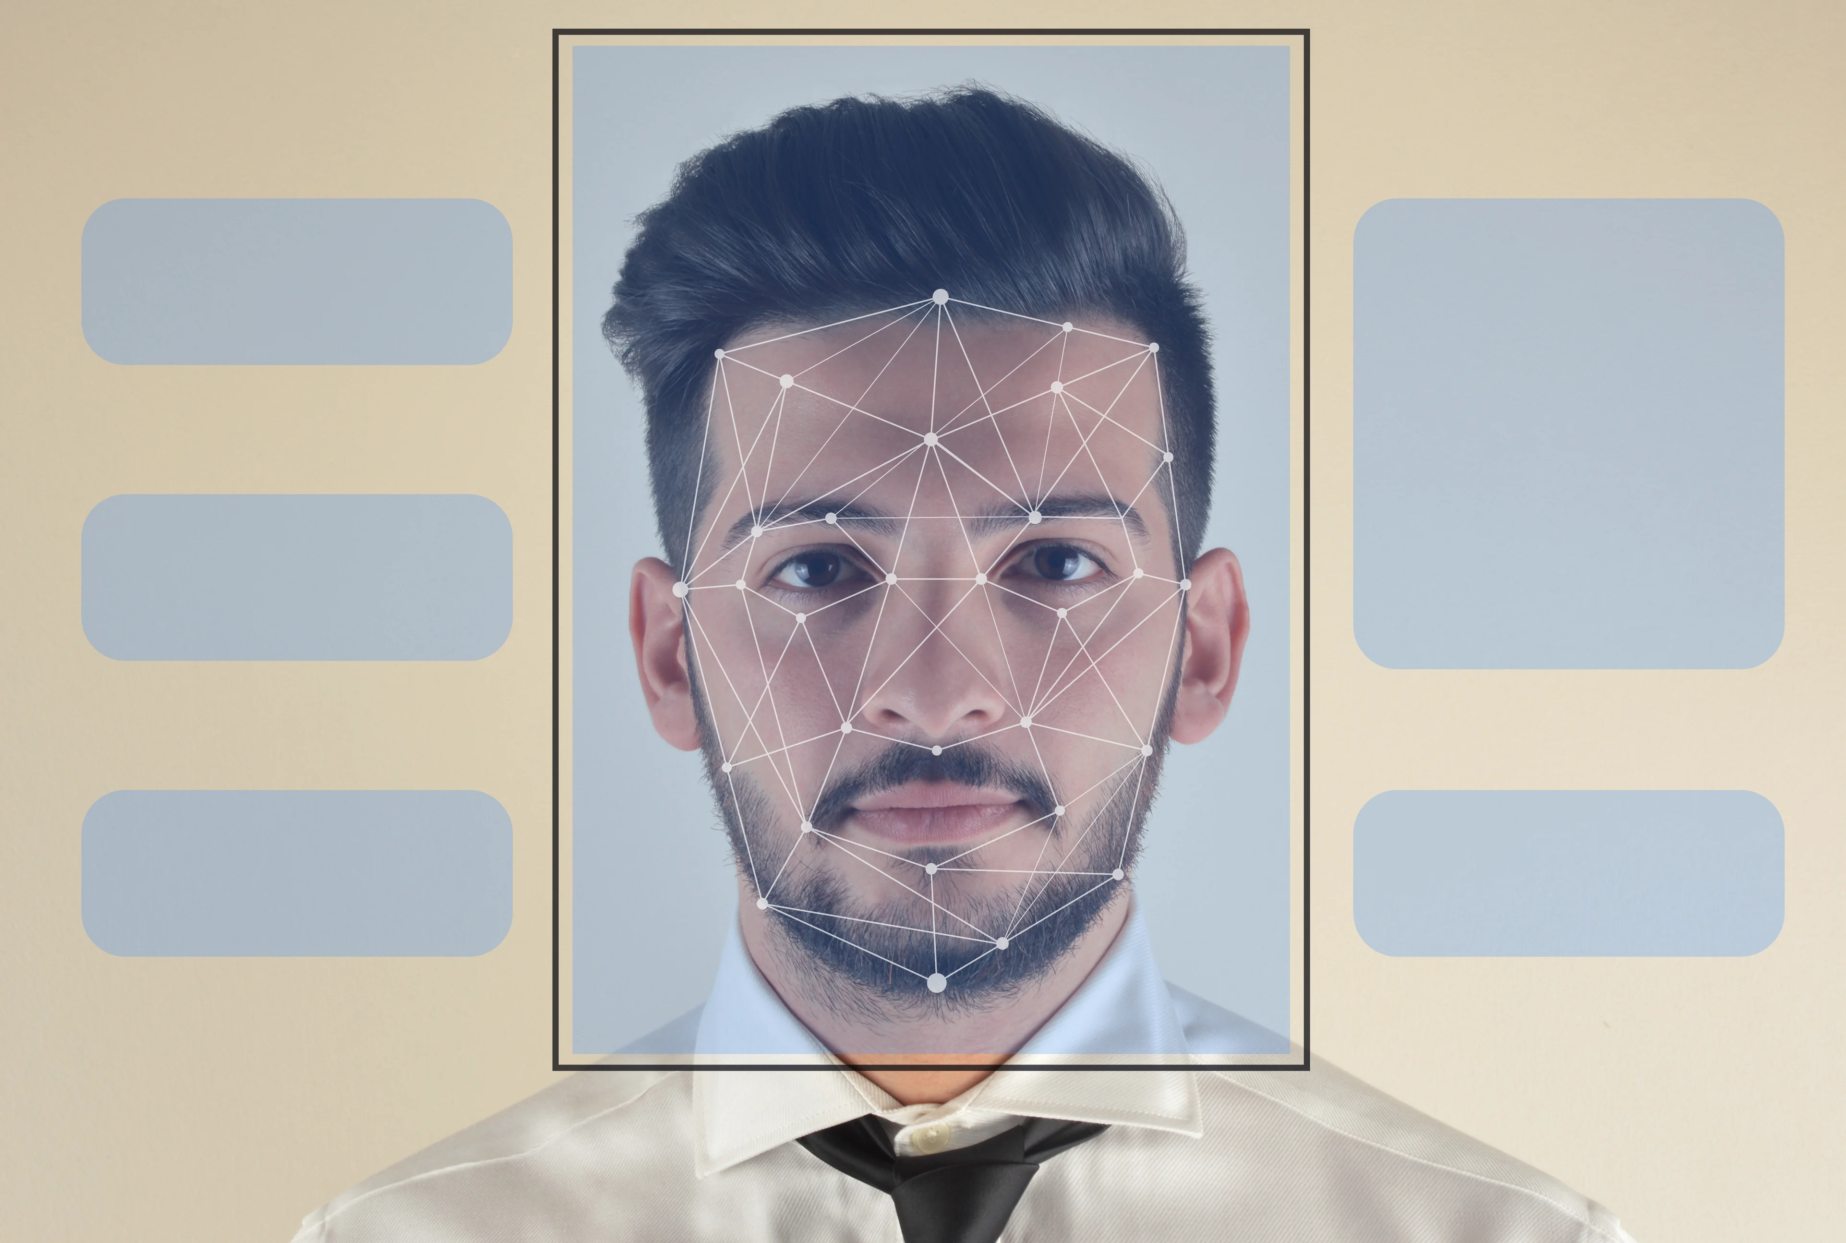
Agenda
Introduction
PROJECT SUMMARY
MEET OUR TEAM
SCOPE OF WORK
TIMELINE
Phases of work
REFERENCES
IMAGE SOURCE: LEARN G2

Slide 3
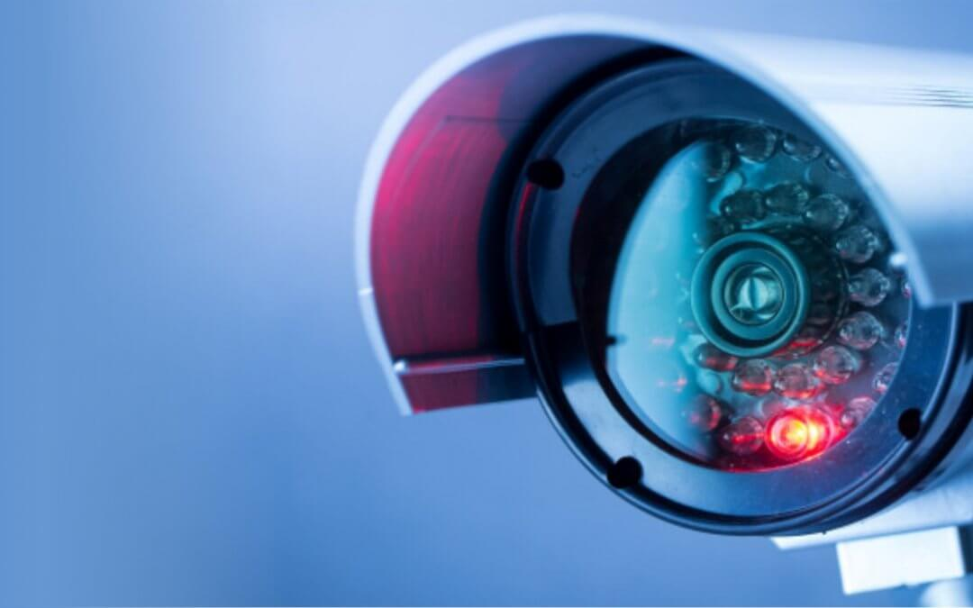
Introduction
What is CRI AI Camera?
CRI stands for Color Rendering Index and is nothing but a specification of cameras which states how accurately artificial light shows colors of the people under them.
CRI AI Thermal camera (PROVIX-N20915 HikVision) is used to develop this project.

Slide 4

Primary goals
Face Recognition
Security and surveillance
Contactless access control

Slide 5
Summary
Facial Recognition is the process of identifying a person through his or her facial features. We will be using thermal cameras to detect human faces. When we think about thermal images in the context of people, what usually comes to mind is night vision. The ability to see a person, or group of people, by the inevitable heat their bodies emit.
An important aspect of our project requires us to understand that thermal images capture heat in the form of frequency of pixels, varying from 0 to 1. Studies have found that each face emits a unique heat signature due to the blood vessels below the skin, as mentioned by Barclay (2013). Therefore, thermal facial images capture unique individual facial heat signatures which mark as unique biomarkers, providing us with rich information to classify a person correctly using a model.

Slide 6



Meet our team
Tilak Pandya
(B.C.A., M.C.A.)
Namra Patel
(B.E Computer Science.)
Kishan Patel
(B.Sc. Physics, PGDCA, Big Data Solution Architecture)
A Big Data Analyst having non-cs bachelor degree, yet significantly interested, and competent in AI industry.
A developer who explores concepts and potential in the tech industry.
A developer with real-world problem solving experience and a desire for innovation.

Slide 7
SCOPE OF WORK
Research on CRI AI thermal camera
Development of facial recognition algorithms
Integration with existing systems
Testing and validation
Deployment and training
Maintenance and support

Slide 8
FLOW OF THE PROJECT

Slide 9
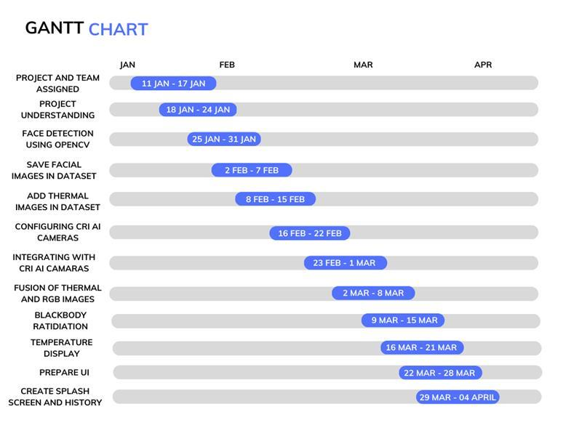

High-level timeline chart (GANTT)

Slide 10

PHASE 1
Defining the project objective
Started by understanding what the project is about and what it seeks to achieve
Allocate roles and responsibilities
Determined the roles and responsibilities of each team member
Establish communication protocols
Chose the best way of communication between the team and the client.
Identify and manage risks
Identified any potential risks that could impact the project's success and develop a plan to manage them.
Stay on top of progress
Monitored progress closely to ensure the project stays on track

Slide 11
PHASE 2
Exploring different libraries
Finalized OpenCV due to its ease of use and functionality for Computer Vision.
Accessing the image source
Initially used webcam as the source of image.
Creating a 4D blob
Converted image into multidimensional array to feed the Deep learning algorithm.
Detecting the Face
Drew rectangle around the face to detect it.
Displaying the confidence rate
Displayed the confidence rate of the detected face.

Slide 12
PHASE 3
CONVERTING IMAGE TO GRAYSCALE
The reason of converting RGB images to grayscale is to reduce the computational processing to process the algorithm faster.
Saving Multiple images in the dataset
Since we did not have image dataset, we started capturing our faces and stored those images in the dataset using unique naming convention to make sure an image does not overlap.

Slide 13
PHASE 4
CONVERTING to Thermal images
Initially, we did not have access to CRI AI Camera, so we converted RGB images to thermal images to identify the unique heat signature of different faces.
Saving Thermal images in the dataset
Stored grayscale and thermal images both with unique naming convention in the dataset to analyze the images accurately.

Slide 14
PHASE 5
SAVING user data in the CSV file
Saved the user data such as name and student id, associated with the user’s face.
Recognizing the faces
Recognize the face of user using OpenCv’s LBPHFaceRecognizer_create model. User’s name will be shown on the rectangle while detecting face
Configuring CRI AI Camera
Successfully configured CRI AI camera using its own IP address, and iVMS – 4200 software.

Slide 15
PHASE 6
Integration of CRI AI camera
Connected CRI AI camera, and started taking video frame from it
Fusion of thermal and Rgb
Make a fusion of captured image by converting an image into thermal image and RGB image
Troubleshooting of latency and Black body radiation box
Try to reduce latency using different aspects
Tried to use black body radiation box for body temperature measurement

Slide 16
PHASE 7
Face recognition using fusion image
Implemented code for recognizing an image using fusion image
R&d of Latency issue and black body radiation box
Worked on how to interconnect CRI AI camera and Black body radiation box
R&D on CRI AI Camera Latency issue

Slide 17
PHASE 8
Facial recognition using Cri Ai Camera
implemented functionality of recognizing an image using CRI AI camera and tested the same
black body radiation box
Configured black body radiation box with CRI AI Camera using iVMS-4200 application.
Configured black body radiation box temperatures to alert the system
Elimination of similar image
Started working on feature to not to capture an image for similar angle

Slide 18
PHASE 9
User interface
Created an UI for better user experience and easy interface for non-IT user
Issue of similar image
Identified and worked on issue of similar image
Solved a problem by using different technique to check the similar image
Latency issue of Cri ai camera
R&D of the problem and tried multiple ways to overcome the latency problem

Slide 19
PHASE 10
Splash screen
In order to serve better UI experience when system get started, implemented splash screen code
History log file
Implemented a functionality for recording actions performed by a user
CRI AI Latency issue
Worked on suggested way such as using ethernet cable, but failed to reduce the latency issue

Slide 20
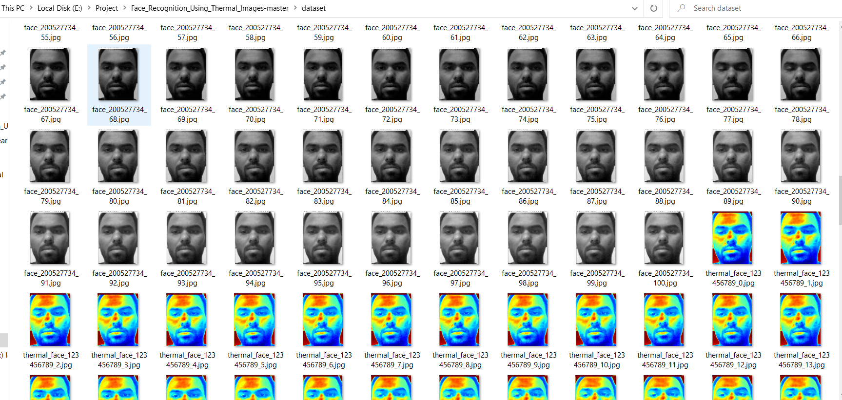
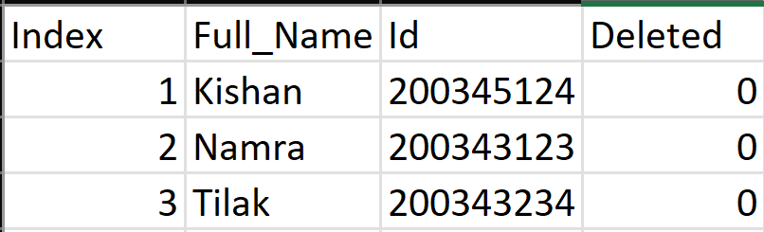
Glimpse of the work done
Sample Dataset
Sample CSV

Slide 21
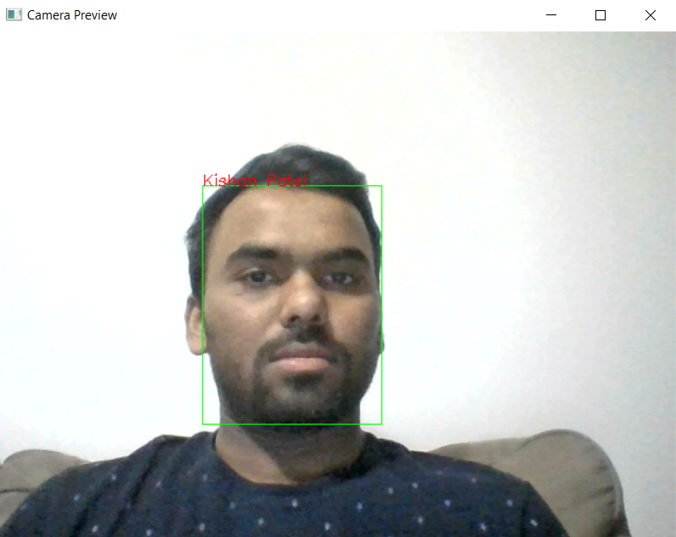
Glimpse of the work done
Face Recognition

Slide 22
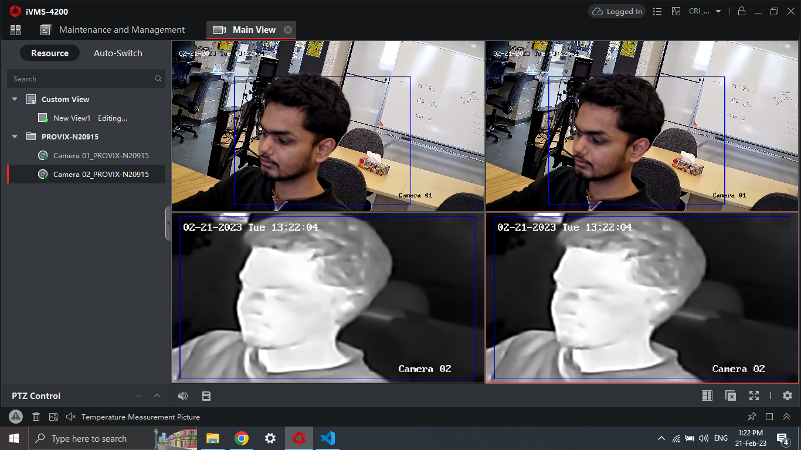
Glimpse of the work done
Accessibility to CRI AI Camera

Slide 23
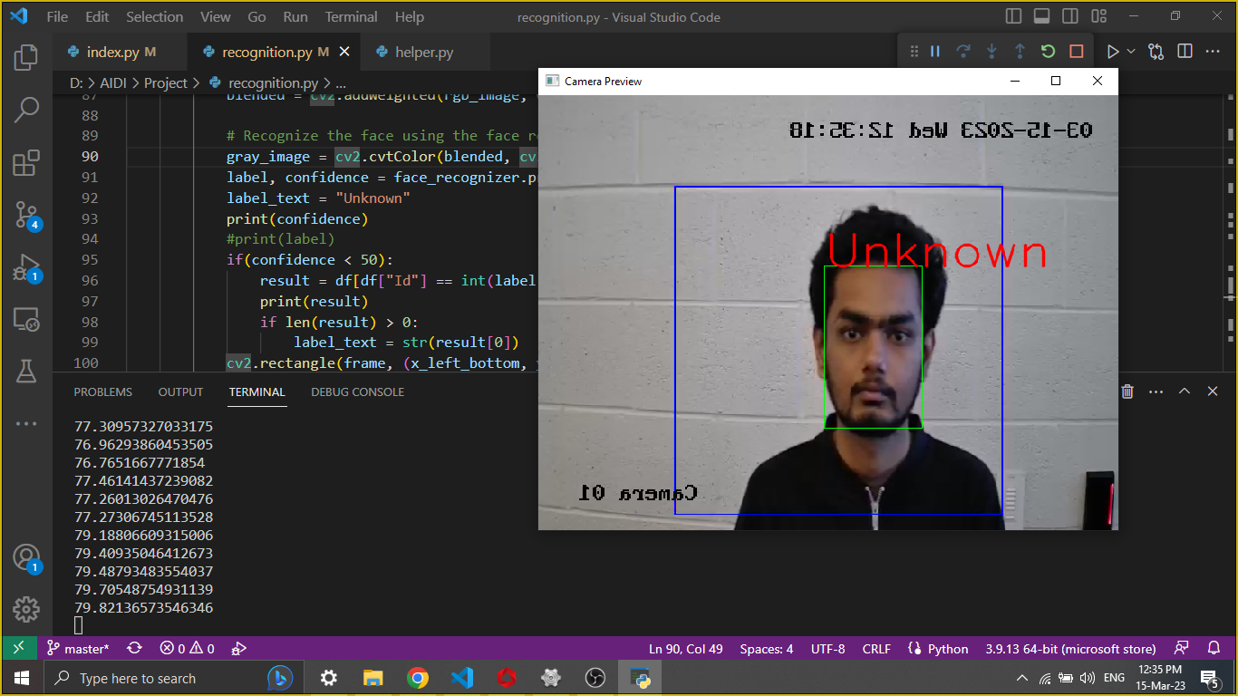
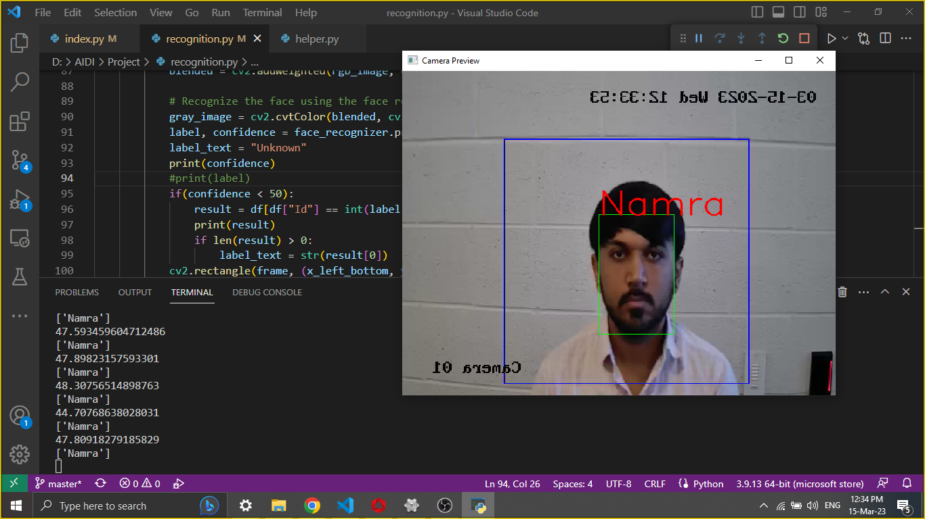
Glimpse of the work done
Face Recognition using CRI AI Camera

Slide 24
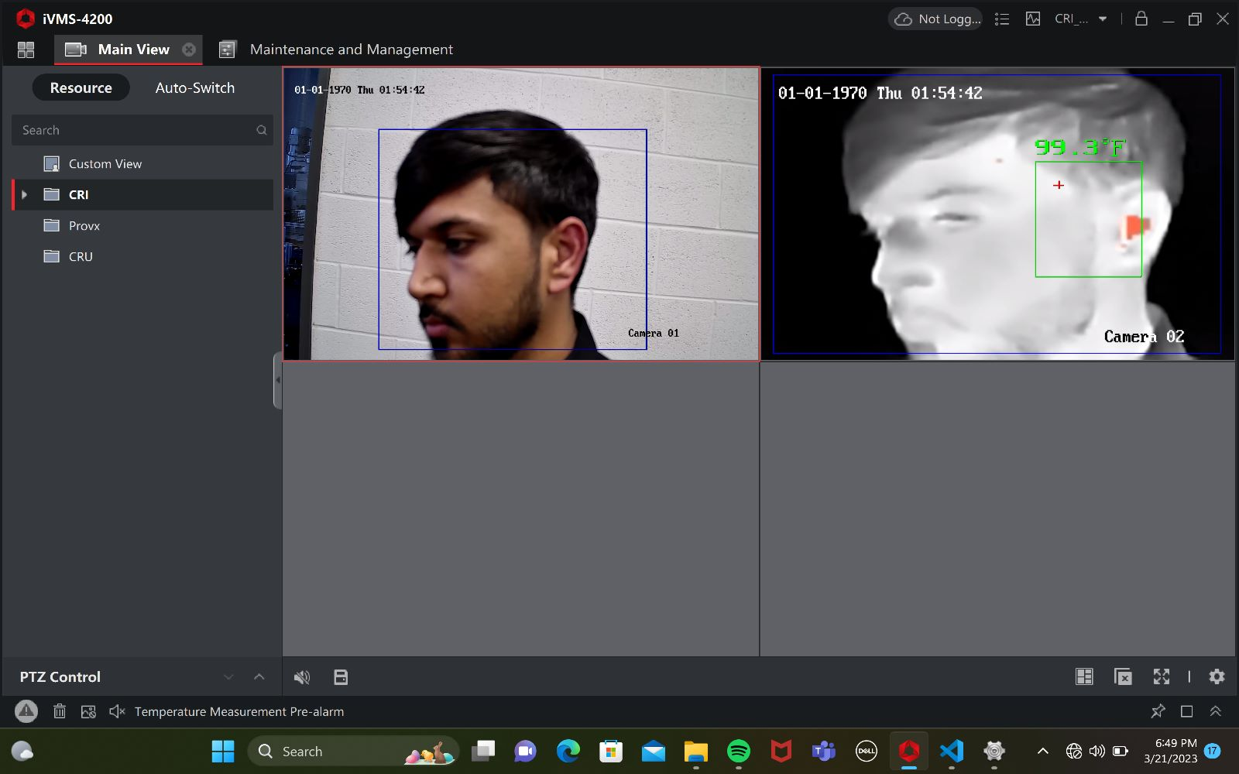
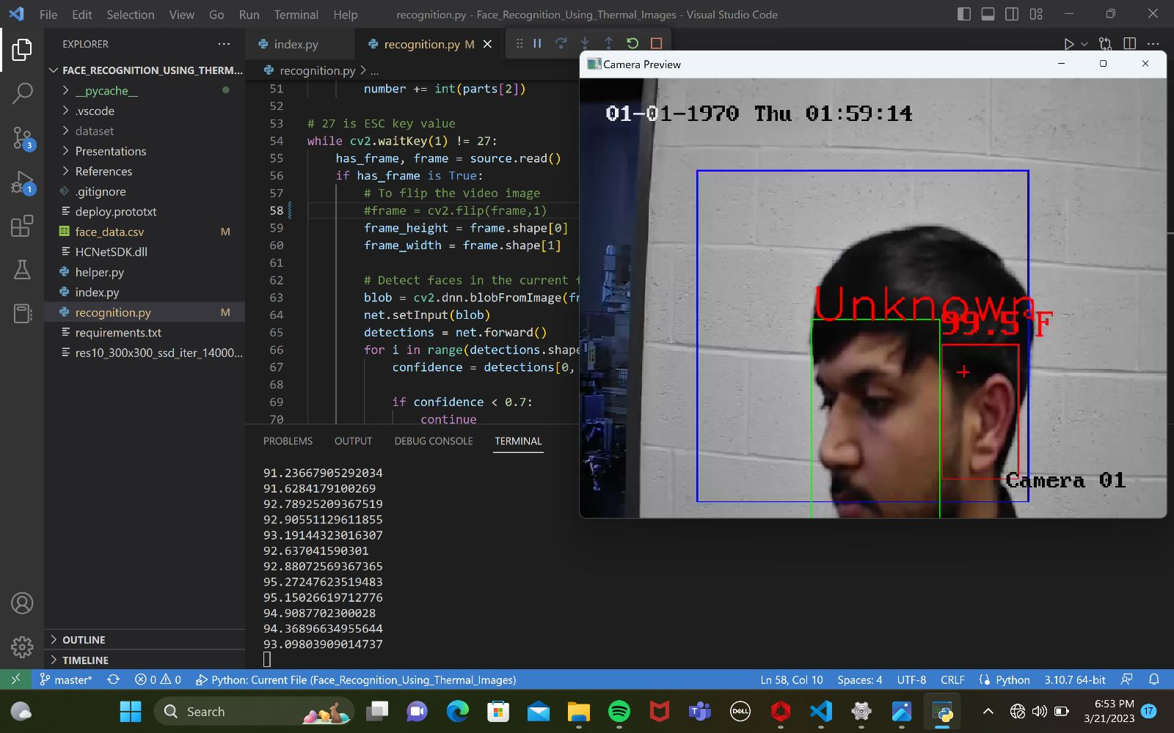
Glimpse of the work done
Blackbody radiation box integrated with camera showing temperature

Slide 25
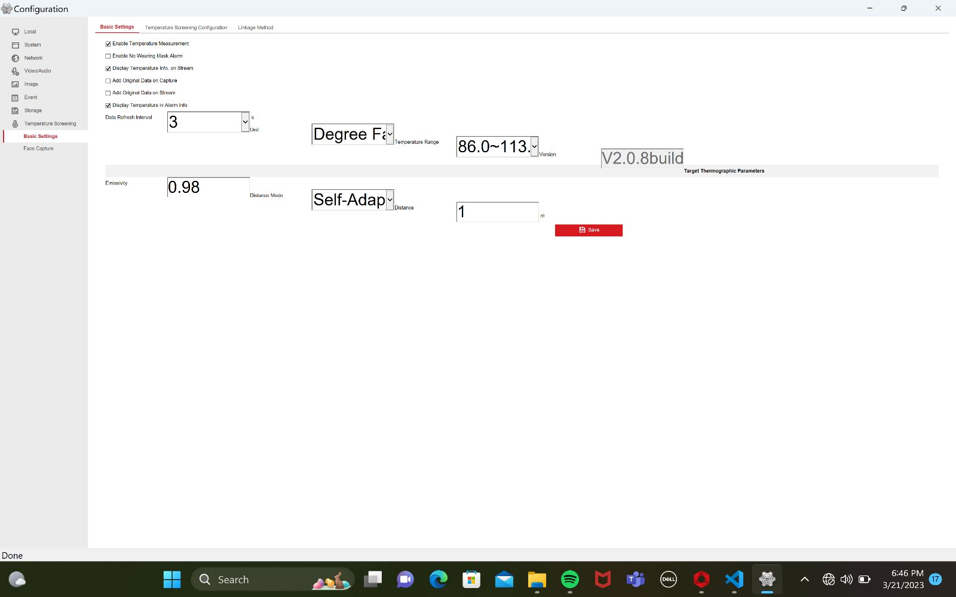
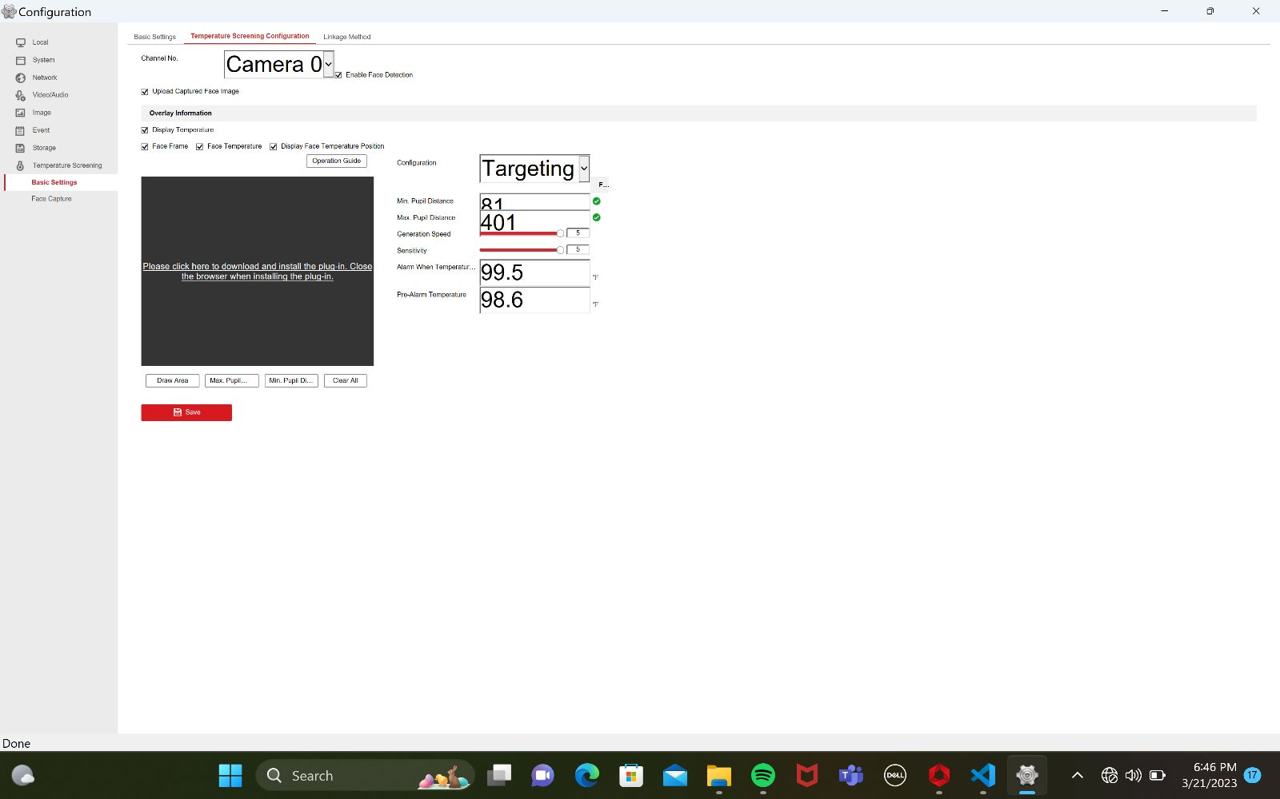
Glimpse of the work done
Camera configuration Change

Slide 26

Glimpse of the work done
Splash Screen

Slide 27
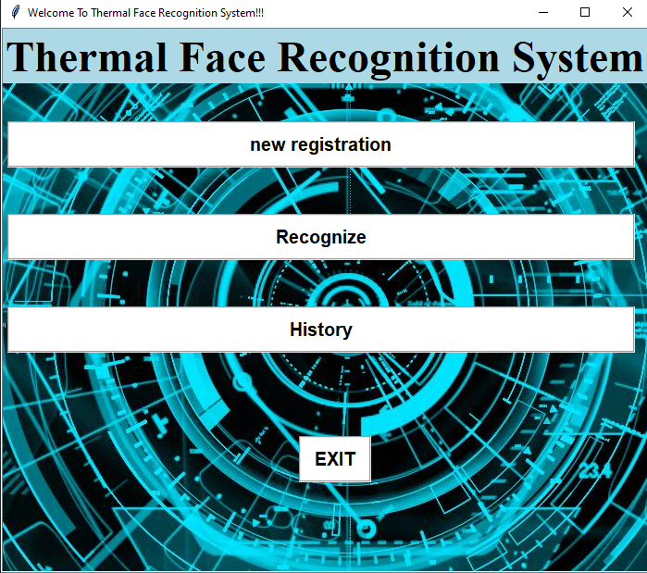
Glimpse of the work done
User Interface

Slide 28
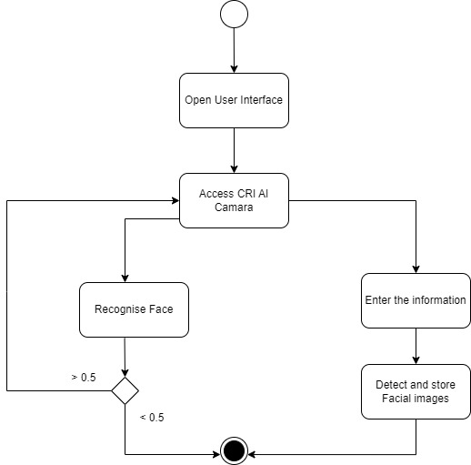
Activity Diagram

Slide 29
Future Work
Latency issue of CRI AI camera
Face Capturing algorithm for different angle
History in details
More user data for wide range of users and dataset
UI for insert / view user data or users list
Functionality to delete user images and user data (Deleted flag has been made for future usage)

Slide 30
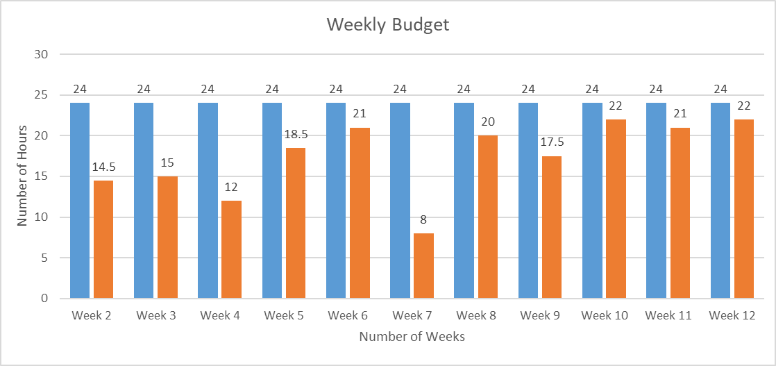
Hours worked (weekly)

Slide 31

General Budget
•Number of developers: 3
•Hourly cost: $50 per developer
•Estimated weekly time: 8 hours per developer
•Estimated weeks: 13
•Estimated fictious budget: $15,600

Slide 32
REFERENCES
iVMS 4200 References •User Manual Of iVMS 4200: https://us.hikvision.com/en/system/files_force/ivms-4200_v2.8.2.2_windows_user_manual_v2_0.pdf?download=1
Software Used: https://www.hikvision.com/ca-en/support/download/software/ivms4200-series/
For More Information FAQs: https://us.hikvision.com/en/support-resources/documentation/faq/software
For more information on the cv2.cvtColor function: https://docs.opencv.org/master/d9/d61/tutorial_py_morphological_ops.html
For more information on the cv2.applyColorMap function: https://docs.opencv.org/master/d3/d50/group__imgproc__colormap.html
For more information on the cv2.imwrite function: https://docs.opencv.org/master/d4/dc0/group__imgcodecs.html

Slide 33

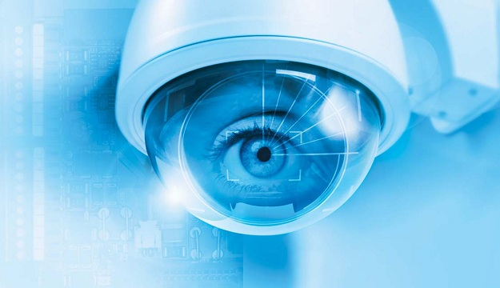
Thank you
GitHUB:
https://github.com/tilakpandya/face_recognition_using_thermal_images

